Slide 1
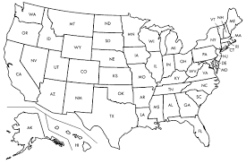


Voter Turnout Analysis
Final Project Bootcamp 2020
45 % of the Americans dont vote

Slide 2
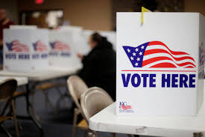

Reasons why we selected this topic:
The reasons our team chose the topic of “Voter Turnout Analysis” was because we think this is something interesting concerning the US elections.
When discussing this topic with the team we asked ourselves how high the voter Turnout in the elections is and why has this number not been able to change in a long time.
Knowing that the US has had a 55% voter Turnout, we decided to analyze different areas of this data to find out why this is a problem.

Slide 3


Questions we hope to answer with the data:
-Which contributing factors are most significant in determining voter turnout within the United States?
-How can we help change this in the future?
-Are the laws of each state affecting the voter turnout?
-This project does not align or support any political affiliation or party, this analysis is merely analyzing the data on voter turnouts and why this is a problem in the USA.

Slide 4

Description of source of data
Our primary data sources are a combination of government data and a privately funded studies:
The United States Census Bureau
www.census.gov
Election Prediction Indicators from MIT
https://electionlab.mit.edu/data
United States Elections Project
http://www.electproject.org/home/voter-turnout/voter-turnout-data

Slide 5
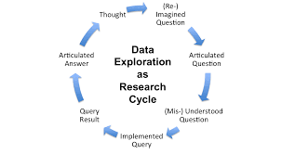
Description of the Data exploration
The data exploration we conducted utilized various datasets that we cleaned.
Part of our data exploration ensured the collection of the amount of registered voters in the United States.
We created unique indices and evaluated which of the collected features might answer our research questions, which ones were irrelevant or sparse, and selected or dropped these features accordingly.

Slide 6
Description of the Analysis phase of the project:
The analysis phase of the project will thoroughly examine voter turnout per state.
We will analyze data on the demographics of voters in the past six Federal elections in the United States.
We will analyze the results without a bias opinion of the data we found.
At first we considered a Linear Regression model, which is a big data analysis of voter turnout. However, we agreed a Random Forest Model would give us more accuracy and less bias for the statistical analysis of voter turnout per state.
We will order the most significant factors and evaluate those which might strongly skew the data, rerunning our model on a modified feature list as needed.

Slide 7
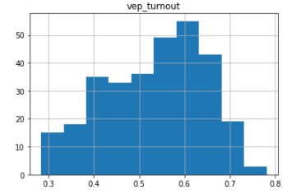
Description of the Analysis phase of the project:
This histogram illustrates the per State distribution of turnout rate in the past six elections - from 2008 to 2018.
The majority of states have approximately 0.6 turnout.
The turnout ranges from 0.28 to 0.78
Our analysis will show the importance of factors contributing to this wide range in turnout
Count by year-state tuple
Turnout rate of “Voting Eligible Population” (VEP)

Slide 8



Communication Protocols:
We as a group will communicate through our Slack Channel, during class and after class hours. During our time we will discuss the outline, tasks for each member, and assistance as needed to complete the segment on time.

